Slide 1
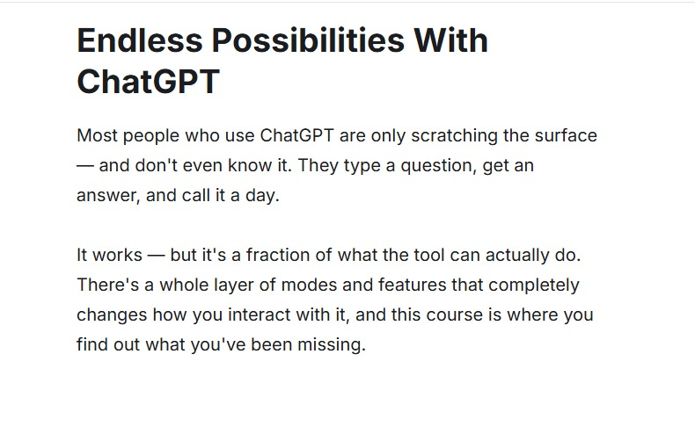
LECTURE
AI Tools, ChatGPT
& Intelligent Agents
From asking questions to delegating tasks
Artificial Intelligence
MSc Mathematics with AI & Data Science
Course inspiration supplied by the instructor
Prof. Namita Tiwari | CSJMU, Kanpur
Today’s core question
When should we use a model, a tool, or an agent?
Updated with official OpenAI sources • 17 July 2026
Notes:
Welcome students and connect this lecture with the previous AI foundations classes. Explain that ChatGPT is not only a chatbot; it is a workspace that can use tools and, in some modes, act as an agent. Ask students to think of one task they currently do manually that AI could assist with.

Slide 2
Learning Outcomes
By the end of this lecture, students should be able to:
01
Distinguish
02
Select
03
Design
AI model, AI tool, assistant, and agent
the right ChatGPT capability for a task
clear prompts with context and output format
04
Apply
05
Evaluate
ChatGPT to mathematics, data science, and research
accuracy, privacy, bias, and academic integrity
Lecture duration: ~40 minutes • Includes demonstration and class activity
Notes:
Read the learning outcomes quickly. Tell students that this is practical AI literacy: what the systems can do, how to ask effectively, and how to verify results.

Slide 3
From Model to Agent
Four related ideas—different levels of capability and autonomy.
Intelligence
+ Capability
+ Interaction
+ Autonomy
AI MODEL
AI TOOL
AI ASSISTANT
AI AGENT
Generates or predicts
Performs one capability
Converses and combines tools
Pursues a goal through steps
Example: a language model produces an explanation.
Example: web search, calculator, code execution.
Example: ChatGPT analyzes a file and explains results.
Example: research, plan, act, check, and report.
Increasing autonomy and tool use →
Notes:
Explain that a model is the reasoning engine, a tool is a specific function, an assistant is the conversational interface that can combine capabilities, and an agent can pursue a goal through multiple steps. Emphasize that autonomy does not mean unlimited permission—the user should remain in control.

Slide 4
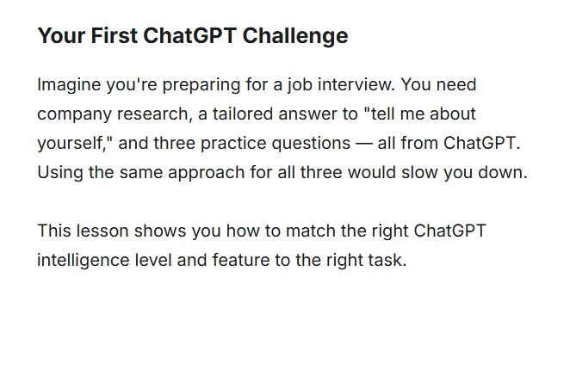
Opening Challenge: One Goal, Different AI Choices
The same prompt strategy is not best for every task.
Fast personal answer
1
Chat / Instant
“Help me introduce myself.”
Current company research
2
Web Search
News, products, leadership, recent events
Evidence-based interview brief
3
Deep Research
Compare sources and produce a documented report
Book the interview and organize files
4
Agent / Apps
Use connected tools and take approved actions
Notes:
Use the interview example to show that choosing the right feature is part of AI literacy. A normal chat is enough for a personal introduction, but current facts require search, a literature-style report requires deep research, and multi-step actions require an agent or connected apps.

Slide 5
ChatGPT: A Multimodal AI Workspace
A single conversation can combine several kinds of input, reasoning, and output.
VOICE
Speak and listen
TEXT
Ask, write, explain
WEB
Current information + sources
ChatGPT
conversation + models + tools
FILES
PDF, PPTX, DOCX, XLSX
IMAGES
Understand, create, edit
DATA
Tables, charts, Python
Source: OpenAI Help — ChatGPT Capabilities Overview; Data Analysis with ChatGPT; Working with Files (accessed 17 Jul 2026).
Notes:
Introduce multimodality: the prompt is not limited to typed text. Students can supply images, audio, and files; ChatGPT can search the web, run data analysis, and create outputs. Availability and limits vary by plan and workspace.

Slide 6
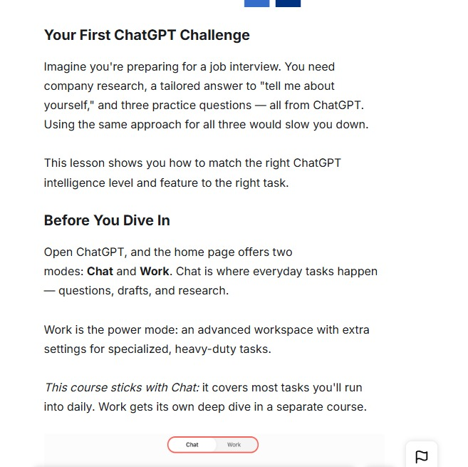
Choosing an Intelligence Level
Use the lightest level that reliably solves the task; escalate when reasoning is harder.
INSTANT
1
Fast
Everyday questions, rewriting, brainstorming, quick explanations
MEDIUM
2
Balanced
Standard analysis, comparisons, structured reasoning, data interpretation
HIGH / THINKING
3
Deeper
Complex multi-step reasoning, proofs, difficult coding, detailed planning
Model names, levels, and limits may vary by plan and can change over time.
Source: OpenAI Help — GPT-5.6 in ChatGPT and ChatGPT release notes (accessed 17 Jul 2026).
Notes:
Relate the levels to mathematical work. Instant can define a concept; Medium can compare methods; High or Thinking is better for a multi-step proof or difficult algorithmic reasoning. Remind students that the interface may show different names depending on account and plan.

Slide 7
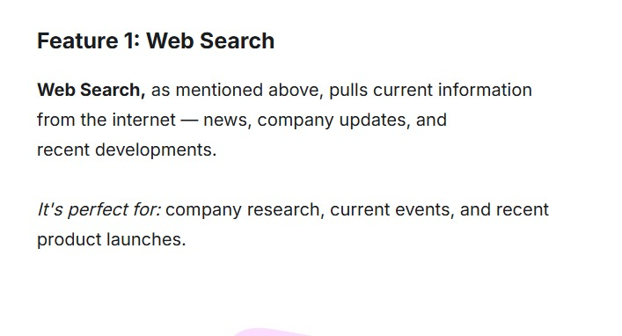
ChatGPT Capability Map
Choose the feature based on the evidence, input, and action required.
SEARCH
DEEP RESEARCH
Current information
Documented synthesis
News, recent facts, source links
Literature review, market or policy brief
FILES + DATA
IMAGES
Analyze evidence
Visual creation
PDFs, spreadsheets, charts, code-backed analysis
Diagrams, infographics, editing and interpretation
Example feature menu
VOICE
APPS / AGENT
Selection rule
Natural conversation
Connect and act
Do I need current facts, a cited report, uploaded evidence, a visual, a conversation, or an action?
Practice, brainstorming, oral explanation
Use external data, complete approved multi-step work
Source: OpenAI Help — ChatGPT Capabilities Overview, Apps in ChatGPT, and ChatGPT agent.
Notes:
Use this slide as the decision map for the rest of the lecture. Ask students to identify which feature they would use for: today’s stock price, a 20-paper literature review, a CSV dataset, a poster, viva practice, and organizing a meeting.

Slide 8
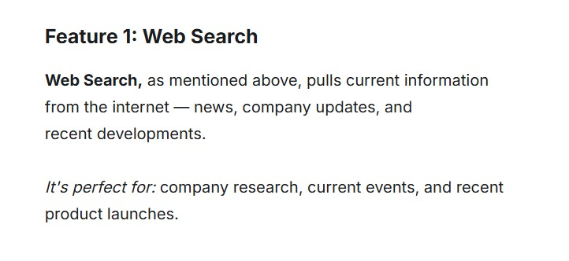
Feature 1: Web Search
Best for recent, changing, or source-sensitive information.
USE SEARCH WHEN
The fact may have changed recently
You need direct sources or links
You are comparing products, policies, events, or current research
You want a quick overview—not a full research report
Example prompt
CHECK BEFORE USING
“Search the web for the latest applications of graph neural networks in cryptography. Give five credible sources and explain why each is relevant.”
Is the source authoritative?
Is the date current?
Do multiple sources agree?
Source: OpenAI — Introducing ChatGPT Search (31 Oct 2024; accessed 17 Jul 2026).
Notes:
Explain that search combines conversational answering with current web information and source links. Demonstrate a recent research query. Teach students to inspect the source, date, and agreement across sources rather than accepting the summary blindly.

Slide 9
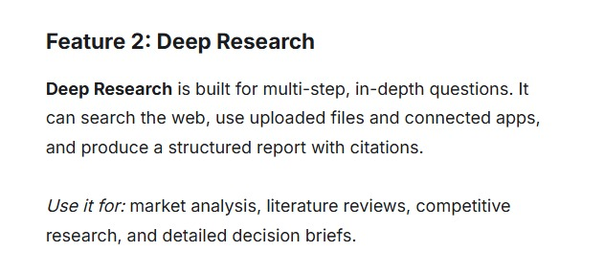
Feature 2: Deep Research
For multi-step questions that require planning, synthesis, and a documented report.
Ideal academic uses
Literature reviews and research-gap mapping
Comparison of algorithms or theoretical approaches
Policy, market, and technology landscape reports
Decision briefs with traceable evidence
1
2
3
Search vs Deep Research
4
5
Search = fast current answer
Deep Research = planned, multi-source, cited synthesis
Define the outcome
Choose sources
Review the plan
Monitor research
Verify the report
Source: OpenAI Help — Deep Research in ChatGPT (updated Jul 2026).
Notes:
Clarify that deep research is agentic research, not simply a longer answer. The user can choose sources, review the plan, monitor progress, and inspect citations. For MSc students, it is useful for mapping a research area, but the final interpretation must remain theirs.

Slide 10
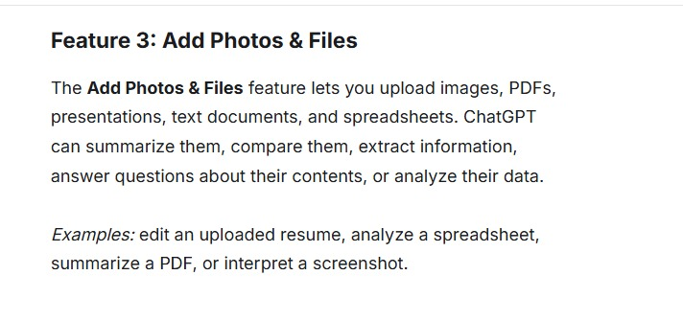
Feature 3: Files & Data Analysis
Turn documents and datasets into structured questions, calculations, tables, and charts.
Mathematics + data science examples
Analyze student marks and identify outliers
Fit a regression model and explain assumptions
Compare numerical methods from a PDF
Generate a radar chart from research data
Check calculations and show reproducible steps
UPLOAD
ASK
ANALYZE
VERIFY
PDF • PPTX • DOCX • XLSX • CSV
Summarize • compare • calculate • extract
Python • statistics • tables • charts
Inspect assumptions, code, and outputs
Source: OpenAI Help — Data Analysis with ChatGPT; Supported File Types; Working with Files (updated Jul 2026).
Notes:
Explain that uploaded evidence grounds the conversation. For data analysis, ChatGPT may write and run Python, create tables, and produce charts. Students should inspect column names, assumptions, code, and numerical outputs. Structured data gives better results than screenshots of tables.

Slide 11
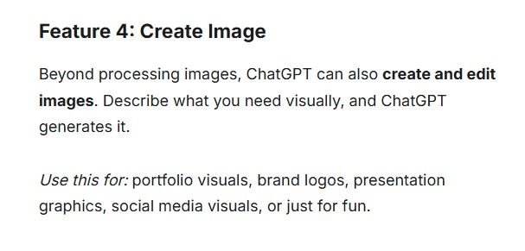
Feature 4: Create & Edit Images
Describe a visual goal in words; iterate until the visual communicates the idea accurately.
DIAGRAMS
TEACHING
Algorithms, architectures, workflows
Concept cards, examples, worksheets
RESEARCH
EDITING
Example prompt for this course
Graphical abstracts and posters
Remove, replace, restyle, or improve visuals
“Create a clean infographic showing the gradient-descent process: starting point, slope, learning rate, iterations, and convergence. Use a white background and classroom-friendly labels.”
Always check labels, equations, units, and visual accuracy.
Source: OpenAI Help — ChatGPT Capabilities Overview; OpenAI — ChatGPT Images 2.0 (21 Apr 2026).
Notes:
Show that image generation is useful beyond art. In mathematics teaching, ask for diagrams, geometric intuition, algorithm flows, and presentation graphics. However, generated equations and labels can be wrong, so check them carefully.

Slide 12
Voice Mode: Learn by Conversation
Speak naturally, hear the response, interrupt, clarify, and continue in the same chat.
1
Viva practice
Ask follow-up questions and receive feedback
2
Concept tutoring
Explain eigenvalues at beginner, intermediate, or advanced level
VOICE
3
Language fluency
Practice academic English or presentation delivery
4
Hands-free learning
Discuss ideas while commuting or reviewing notes
Tip: Ask the voice assistant to pause, quiz you, or correct only one issue at a time.
Source: OpenAI Help — ChatGPT Voice; OpenAI — Introducing GPT-Live (8 Jul 2026).
Notes:
Invite one student to try a short voice interaction. Example: “Act as a viva examiner. Ask me one question about gradient descent, wait for my response, then give feedback.” Mention that current voice can maintain a natural conversation and may show visual answers, but availability differs.

Slide 13
Apps, Connectors & Plugins
Connect ChatGPT to external information and actions—subject to permissions and workspace controls.
CUSTOM APP
Use organization tools
FILES
Search documents
DRIVE
Reference stored content
ChatGPT
EMAIL
Read or draft
SLACK
Search or take actions
CALENDAR
Find time or schedule
Permission principle: connect only what is needed, review requested actions, and protect sensitive data.
Source: OpenAI Help — Apps in ChatGPT; ChatGPT agent; workspace controls (accessed 17 Jul 2026).
Notes:
Explain that apps connect ChatGPT to external data and actions. Some integrations can search only; others can act, such as scheduling or updating a tool. In universities, admin settings, permissions, and data governance are essential.

Slide 14
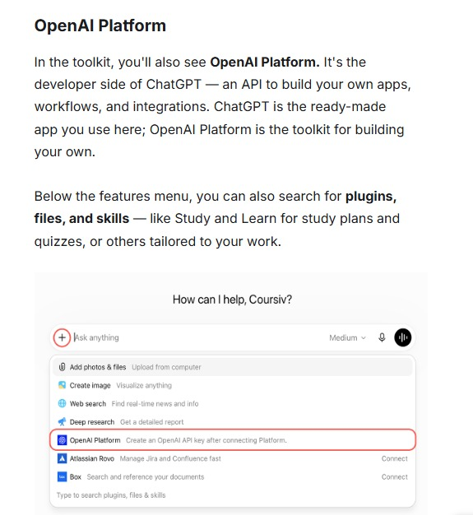
OpenAI Platform: Build Your Own AI Application
ChatGPT is the ready-made product; the platform/API is for developers and organizations.
CHATGPT
PLATFORM / API
Ready-made interface
Conversation, files, search, voice
Useful without programming
Best for individual and team workflows
Build custom apps
Integrate models in software
Control prompts, tools, and workflow
Use APIs, SDKs, and deployment controls
Source: OpenAI developer documentation and ChatGPT overview (accessed 17 Jul 2026).
Notes:
Use a simple analogy: ChatGPT is like a complete calculator application; the API is like the mathematical engine developers can embed in their own software. Mention university examples: admission assistant, research dashboard, or personalized tutor.

Slide 15
What Is an AI Agent?
An agent does more than answer: it works toward a goal through a sequence of decisions and tool calls.
1
2
3
4
5
GOAL
PLAN
TOOLS
ACTIONS
CHECK
Desired outcome
Break into steps
Search, code, apps, files
Execute approved steps
Evaluate and adjust
Agent = Model + Goal + Memory/Context + Tools + Feedback Loop + User Control
Important: an agent may still make mistakes; permissions, checkpoints, and verification remain necessary.
Source: OpenAI Help — ChatGPT agent (accessed 17 Jul 2026).
Notes:
Define the agent clearly. It receives a goal, plans, selects tools, takes actions, checks progress, and revises. The user should approve sensitive or consequential actions. Use the equation on the slide as a memorable definition.

Slide 16
The Agent Loop
Agents repeatedly observe, reason, act, and evaluate until the goal is reached or the user stops them.
1. OBSERVE
Read the goal and context
5. ADAPT
2. PLAN
Revise the plan or ask the user
GOAL
Choose the next step
with user control
4. EVALUATE
3. ACT
Check result and constraints
Call a tool or perform an action
A good agent stops when the goal is met, blocked, risky, or ambiguous.
Notes:
Walk clockwise through the loop. Give a simple example: planning a seminar. Observe requirements, plan tasks, search speakers, draft an agenda, check dates and constraints, then adapt. The loop continues until completion or a user decision is needed.

Slide 17
Case Study: Organize a Research Scholar Seminar
Compare a normal chat response with an agentic workflow.
NORMAL CHAT
AGENTIC WORKFLOW
Prompt: “Plan a research seminar.”
Goal: “Prepare the seminar plan and complete approved coordination steps.”
Suggests agenda and checklist
Drafts invitation text
Provides ideas and templates
You manually verify dates, contact people, and execute actions
Reads files and requirements
Checks calendar and constraints
Researches speakers and summarizes evidence
Drafts agenda, email, and registration material
Requests approval before consequential actions
Reports what was completed and what remains
Source: OpenAI Help — ChatGPT agent and Apps in ChatGPT.
Notes:
Emphasize the difference between generating a plan and carrying out a workflow. The agent can use connected data and tools, but actions should be reviewed. This example is close to university administration and helps students see practical automation.

Slide 18
Applications for Mathematics, AI & Data Science
Use AI to support thinking—not to replace mathematical understanding.
CONCEPT EXPLANATION
PROBLEM VARIATIONS
DATA ANALYSIS
Explain eigenvectors with geometry, algebra, and an everyday analogy.
Generate graded practice questions and hints—not only final answers.
Clean data, compute statistics, visualize patterns, and inspect code.
ALGORITHM STUDY
RESEARCH SUPPORT
COMMUNICATION
Compare complexity, assumptions, strengths, and failure cases.
Search literature, map gaps, summarize evidence, and format notes.
Prepare slides, viva questions, graphical abstracts, and explanations.
Best practice: Ask for reasoning, assumptions, checks, and alternative methods.
Notes:
Connect each example to students’ curriculum. Stress that AI can generate explanations and code, but mathematical learning comes from understanding definitions, assumptions, derivations, and verification.

Slide 19
Prompting Framework: T–C–O–C–V
A strong prompt tells the system what to do, why, how to present it, and how to check it.
T
C
O
C
V
TASK
CONTEXT
OUTPUT
CONSTRAINTS
VERIFY
State the exact job
Give background, level, data, and purpose
Specify structure, tone, length, or format
Set boundaries, sources, notation, and exclusions
Ask for assumptions, checks, citations, or uncertainty
WEAK PROMPT
STRONG PROMPT
“Explain neural networks.”
“Teach a beginner MSc Mathematics class how a one-hidden-layer neural network works. Connect each step to matrices and functions. Use one numerical example, a simple diagram description, and five check questions. State assumptions and flag any simplifications.”
Unclear level • no purpose • no output format • no check
Source: OpenAI Help — Creating a good prompt; OpenAI Academy — Prompting fundamentals (2026).
Notes:
Teach the mnemonic TCOCV. OpenAI’s core guidance is to state the task, provide helpful context, and describe the ideal output. Add constraints and verification for academic work. Compare the weak and strong prompts aloud.

Slide 20
Responsible Use: Trust, but Verify
AI can be confident and still be wrong. Academic users must remain accountable.
HALLUCINATION
Fabricated facts, references, or explanations
→
Verify with primary sources
MATH ERRORS
Incorrect algebra, hidden assumptions, or faulty proof steps
→
Recalculate and test edge cases
PRIVACY
Sensitive student, research, or institutional data
→
Minimize, anonymize, and follow policy
BIAS
Unequal or incomplete patterns in data and language
→
Compare perspectives and inspect evidence
ACADEMIC INTEGRITY
Unacknowledged AI-generated work or over-reliance
→
Follow course rules and disclose assistance
Human responsibility: define the goal • review evidence • approve actions • own the final decision
Source: OpenAI system documentation and general guidance on model limitations and user control.
Notes:
Emphasize that ChatGPT is a support tool, not an authority. For mathematical work, students should verify every derivation and test examples. For research, use primary sources and do not invent citations. Discuss local academic-integrity rules.

Slide 21
Class Activity: Match the Task to the Capability
Work in groups for 6 minutes, then share one prompt and one verification step.
Current Research
Web Search
Evidence Synthesis
Deep Research
A
B
Find three recent applications of topological data analysis and cite authoritative sources.
Compare five methods for time-series anomaly detection and recommend a method for a given dataset.
Deliverable: prompt + expected output + verification plan
Deliverable: prompt + expected output + verification plan
Dataset Analysis
Files + Data
Agentic Workflow
Agent + Apps
C
D
Upload a CSV of student scores, identify patterns, and create an appropriate chart.
Prepare a two-day AI seminar plan using files, calendar constraints, and approval checkpoints.
Deliverable: prompt + expected output + verification plan
Deliverable: prompt + expected output + verification plan
Notes:
Divide the class into four groups. Each group writes a prompt using the TCOCV framework and names the correct capability. After six minutes, each group shares one prompt and one verification step.

Slide 22
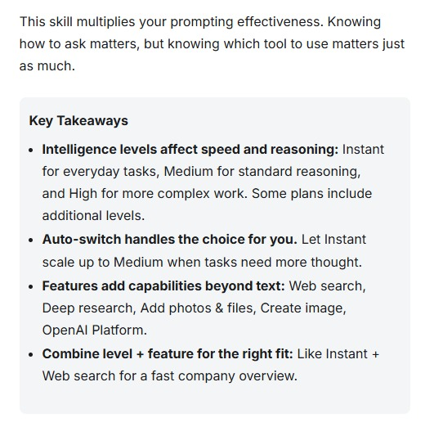
Key Takeaways
The best AI user chooses the right level, the right feature, and the right verification.
AI models reason and generate; tools add specific capabilities.
1
Search is for current facts; Deep Research is for documented synthesis.
2
Files, data, images, and voice make ChatGPT multimodal.
3
Agents pursue goals through planning, tools, actions, and feedback.
4
Clear prompts and human verification determine the quality of outcomes.
5
Next lecture: Voice, custom GPTs/skills, and building a simple agent workflow
Notes:
Summarize the lecture in five sentences. Ask students to give one example of when they would use search, deep research, data analysis, and an agent. End by reinforcing that effective AI use is a combination of capability selection, good prompting, and verification.

Slide 23
Official Sources & Further Learning
OpenAI sources used to update this lecture on 17 July 2026.
01
OpenAI Help Center — ChatGPT Capabilities Overview
06
OpenAI Help Center — ChatGPT Voice; OpenAI — Introducing GPT-Live
02
OpenAI — Introducing ChatGPT Search
07
OpenAI Help Center — Apps in ChatGPT
03
OpenAI Help Center — Deep Research in ChatGPT
08
OpenAI Help Center — ChatGPT Agent
04
OpenAI Help Center — Data Analysis with ChatGPT
09
OpenAI Developer Documentation — Models and Platform
05
OpenAI Academy — Working with Files; Prompting Fundamentals
10
OpenAI — Introducing ChatGPT Images 2.0
Feature names and availability may change. Always check the current official Help Center and your plan/workspace settings.
Notes:
This reference slide documents the official sources used. Encourage students to consult current official help pages because AI products change rapidly.

